Slide 1
Case Study - Interiors
Satven’s Expertise in Interior Design & Development paved way to strengthen customer’s R&D centre resulting us to become a most trusted strategic partner
Client’s Profile
Our Clients are top 10 Major Global OEM’s and Tier-1’s. Their Vehicle Interior team is looking for an engineering partner who provides Program level support taking complete responsibility for Design & Development. The successful execution of various Program level support made them realize that Satven is the right company to partner with
Challenges
Right Engineering partner who provides Program level support in Interior system Design & Development starting from studio Engineering, Competitor Benchmark Study to the new product design & development for Interiors including CAD & CAE.
Design for Modularity.
Alternative materials to reduce weight.
Early market launch.

Slide 2
Case Study - Interiors
Our Solution
Satven Interior Product Engineering team provided the following solutions for the Customer challenges
Our parametric design methodology saved a few iterations thereby reducing design development time
Design for Modularity achieved by
Creating Standard Library attachment features like dog houses, screw bosses, clip towers etc. for building quick assemblies for the feasibility checks.
Developing automated environment assemblies using Macro tools.
Alternative material design achieved by
Expert opinion from other domain areas like aerospace in developing the alternate bumper designs
Study and capture learning's from existing composite designs
Learning's from previous programs
Pro-actively making the library of information on the attachments and different design techniques
Onsite – Offshore business model with Milestone based Resource ramp up to reduce and optimize the product development cycle.

Slide 3
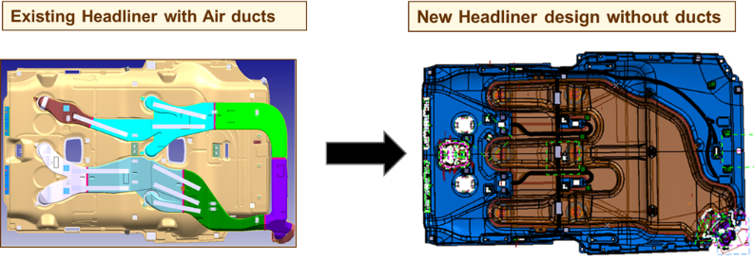
Case Study - Interiors
Benefits To Client
Achieved 20 % weight reduction using Alternative material & manufacturing process for IP assembly.
40% cost savings achieved for Headliner assembly using card board material (PU + glass fibre layer).
Achieved better flow rate than the existing design.
Multiple blow mould air ducts were eliminated by single Air cap part and reduced Headliner assembly Cycle time by 30%.
Combined Design & FEA value added solutions from Satven could allow Customer to achieve the Design Milestone 2 months earlier than the planned schedule.

Slide 4
Case Study - Interiors
Satven Support In Interiors

Slide 5
Case Study - Interiors
Customer Testimonial
“ Excellent Support from Satven Interiors team for Hyper car program. You have done a fantastic job delivering this program much ahead of build schedule. Looking forward to collaborate again in the upcoming programs “
- Head of Programs

