Slide 1
Case Study - Body & Closures
How Satven’s expertise in BIW Design & Development paved way for strengthening customer’s R&D centre
Client’s Profile
Our Client is one among top 10 Major Global OEM’s.
Why the client chose Satven?
Their body engineering team was looking for an engineering partner who provides Program level support taking complete responsibility for BIW Design & Development. The successful execution of various Program level support made them realize that Satven would be the right company to partner with.
Challenges
Finding the right Engineering partner who provides Program level support from Competitor Benchmark Study to the new product design & development for Body Engineering including CAD & CAE.
Light weight BIW with cost effective solution.
Lowering the cost of BIW fabrication.

Slide 2
Case Study - Body & Closures
Our Solution
Satven Body Engineering team provided the following solutions for the Customer challenges
Light weight BIW design support achieved by
Maintaining Knowledge repository of expert opinions from other domain areas like Aerospace in alternate materials and process
Book shelf of learnings & best practices from past program supports.
Proactive material library with information on strength, manufacturing process & cost.
BIW specific training & orientation by Domain experts
Alternative BIW fabrication techniques & design for Modularity were achieved by
Creation of standard library for latest attachment techniques for welding, rivets, adhesives & Bolting etc.
Developing automated environment assemblies using Macro tools for Spot welding and other connections.
Onsite – Offshore business model with Milestone based Resource ramp up to reduce and optimize the product development cycle.

Slide 3
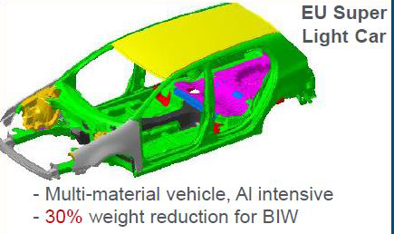
Case Study - Body & Closures
Benefits To Client
Achieved 30% weight reduction for BIW through Multi material usage
15% cost savings achieved using SPR (Self Pierce Rivets) joining techniques in BIW assemblies.
Satven’ s Business model of maintaining onsite (20%) and offshore (80%) reduced the cost of Product Design by 30%
Combined Design & FEA value added solutions from Satven could allow Customer to achieve the Design Milestone 2 months earlier than the planned schedule.

Slide 4
Case Study - Body & Closures
Customer Testimonial
“ Team,
I would like to say how proud I have been to be part of the VAN program and to have worked with you all over the past 3 years. You are a fantastic team. You have done a fantastic job delivering this program.
And VAN is a fantastic product!
I sincerely hope you’re as proud of what you’ve delivered as I am and I wish you continued success through Launch. ”
Program Head

Slide 5
Case Study - Body & Closures
Satven Support In Body & Closures

