Slide 1
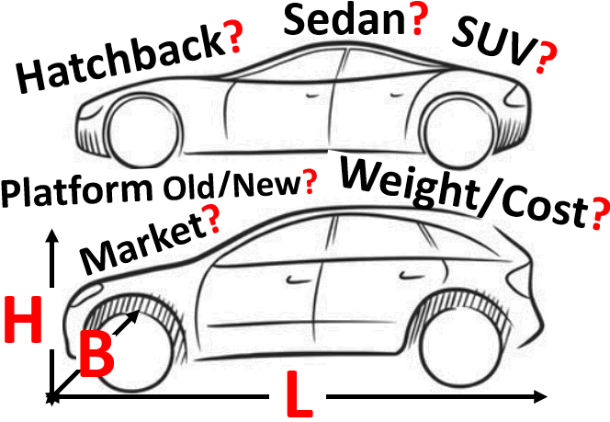
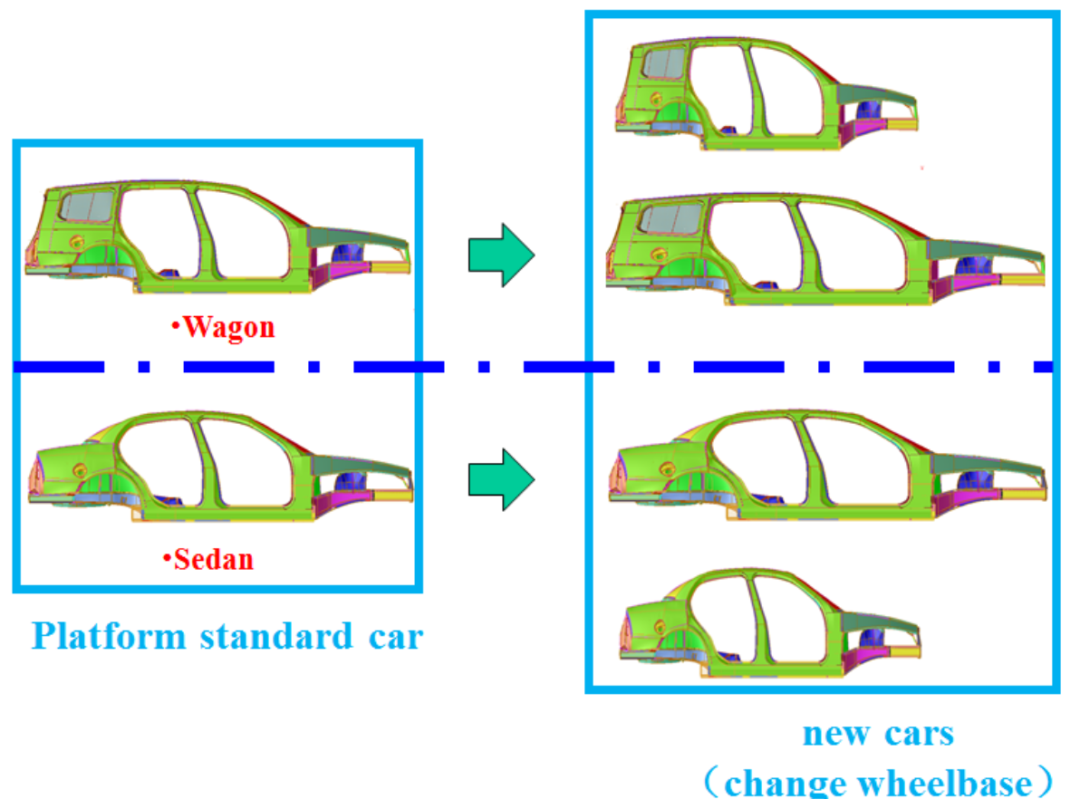
Faster GTM: Simulation-Driven Design (SFE Concept)
(Strukturanalyse in Forschung und Entwicklung)
Customer:
A marquee Japanese Automotive OEM
Pain Points:
Recent trends in the automotive industry demand innovative approaches to hasten vehicle development. The following are some specific pain points to be addressed:
The need to generate myriad CAD and CAE model variants
The need to generate separate models for different physics (Safety, N&V, and Durability)
Long waiting time for CAE results / optimization results to finalize the CAD / Design
Our Solution:
Parametric modeling by SFE is an optimum solution to reduce development times
Parametric Modelling

Slide 2
Our Solution:
Vehicle Development Cycle
Concept & Development
Design Freeze
Conventional
CAD Design
CAE Model / Simulation
1
set of results
Final CAD
Final CAE Simulation
SFE Concept (Parametric Model)
Time Saver!
SFE Model
CAE
1 to n set of results
Final CAD
Final CAE Simulation
Benefits:
Cost & Time : Total vehicle development cycle time reduced by 4-6 months
Concept Level : Rapidly determined the best concept design and thus reduced R&D time
Product Level : Created different models (Hatchback, Sedan, and SUV) quickly
Reduced late stage design modifications
CAE Validation : Used common models for all the domains - Safety, NVH, and Durability
Testimonial from Customer
The XX program plans to use SFE instead of CAD for development. We look forward to your continued support of the SFE team

