Slide 1
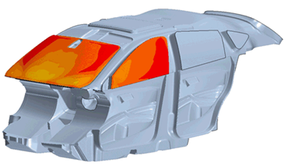
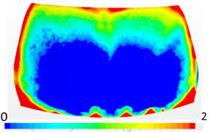
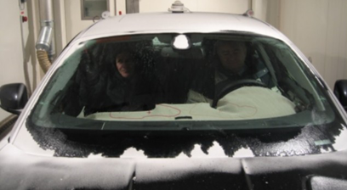
Accurate Deicing & Defogging methodology to reduce testing cost by 50% and validation time by 40%
Customer: Reputed NA OEM, involved in design and manufacturing of electric vehicles.
Pain Points:
Long cycle time for validating the designs through physical testing for deicing and defogging.
Lack of accurate approach for prediction of Deicing and Defogging phenomena.
High cost involved in physical testing.
Existing approaches are inaccurate and highly iterative.
Satven’s Solution:
Developed accurate simulation methodology for Deicing and Defogging with multiphase approach.
Results/Benefits:
Reduced physical testing cost by 50%.
Reduced design validation time by 40%
Improved accuracy of virtual predictions through fast, reliable and accurate simulation approach. This has reduced the design iterations by 20%.
All the above benefits have improved the competitiveness of customer.

